Slide 1
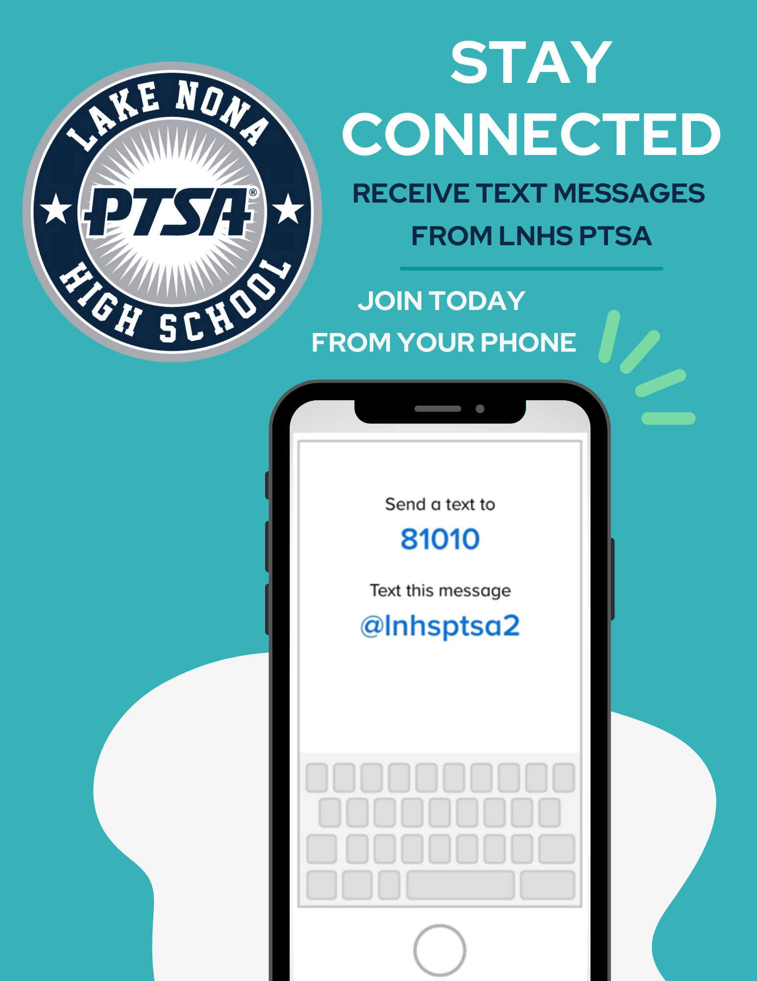
WELCOME
LNHS PTSA GENERAL MEETING
WEDNESDAY
AUGUST 21, 2024
6:30PM
MEDIA CENTER
www.LNHSPTSA.com

Slide 3
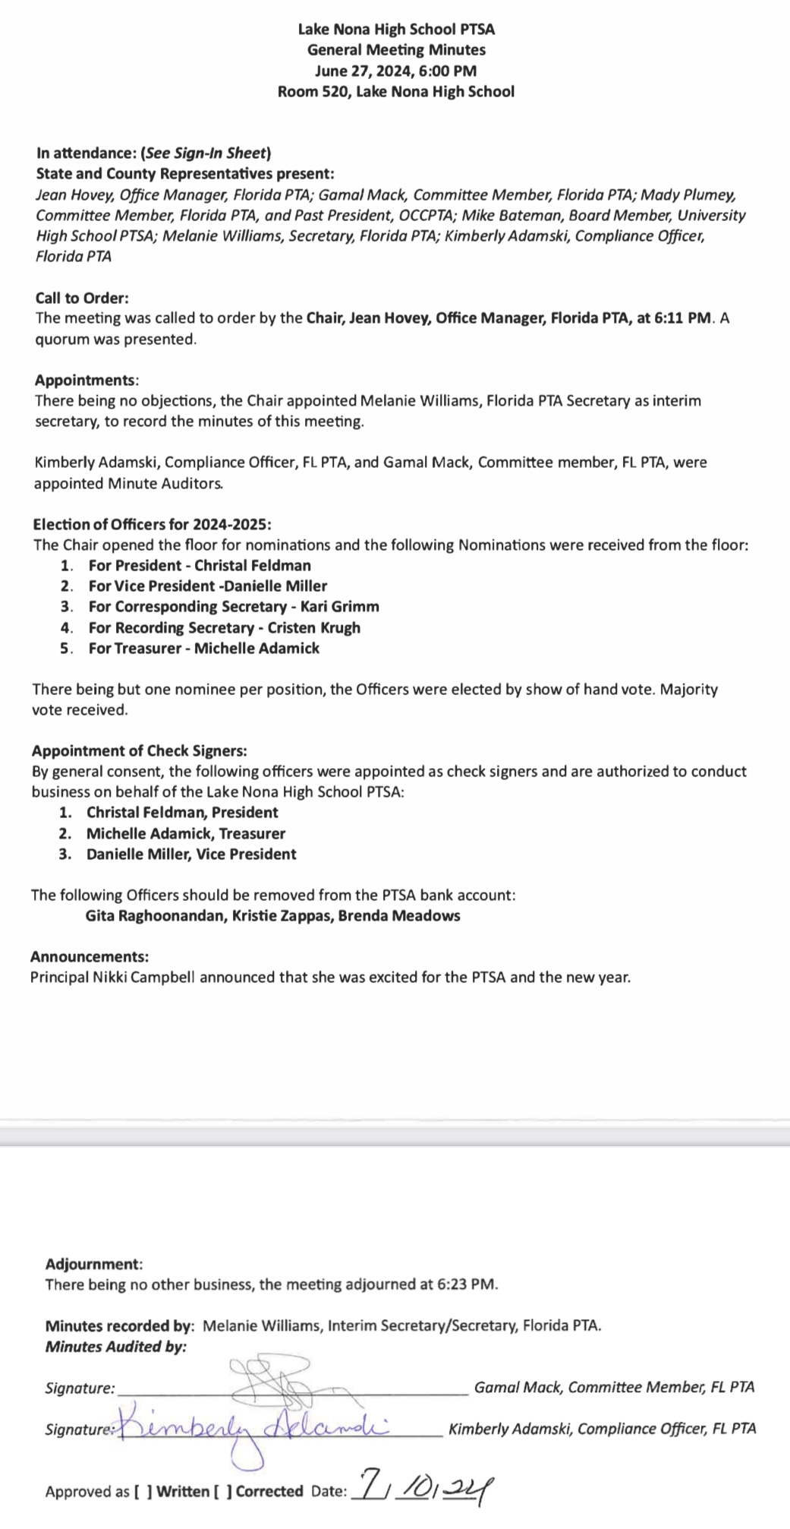
PAST MINUTES
JUNE 27, 2024 FOR APPROVAL 2024 - 2025 Election Meeting

Slide 4
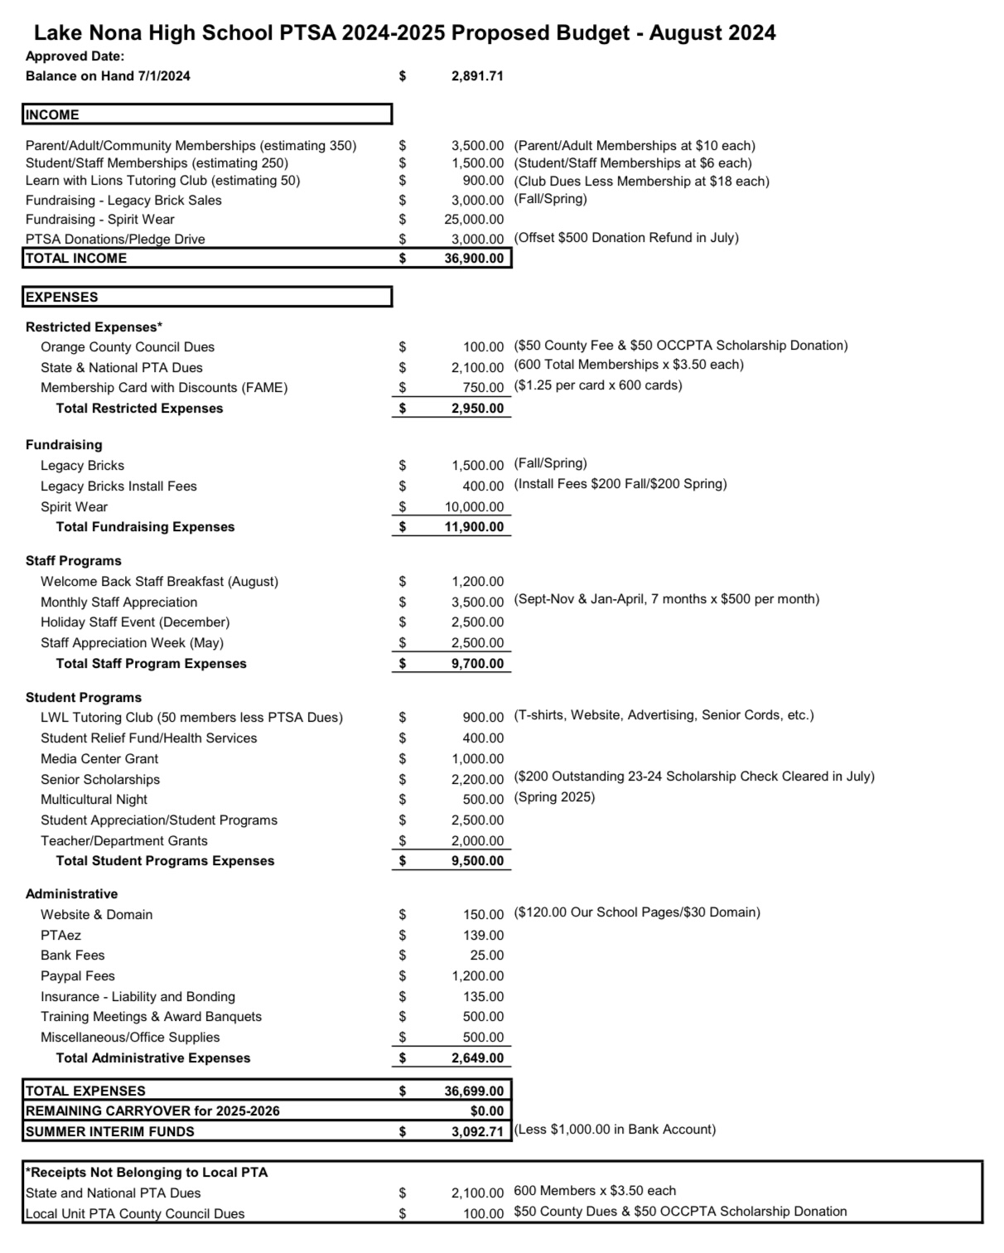
PROPOSED
2024 - 2025
ANNUAL BUDGET FOR APPROVAL 2023-2024 Audit is Due August 31st Starting Balance - $2,891.71
Less (2) Outstanding Checks that totaled $700.00
$2,191.71 (Keep $1,000 Balance in Bank Account)
$1,191.71

Slide 8
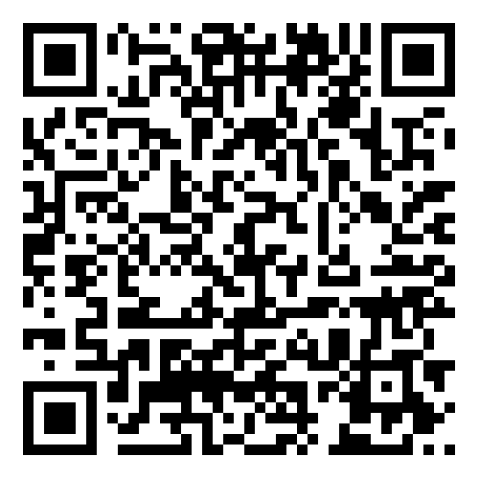
EMAIL - LNHSPTSA@gmail.com
WEBSITE - www.LNHSPTSA.com

